Slide 1








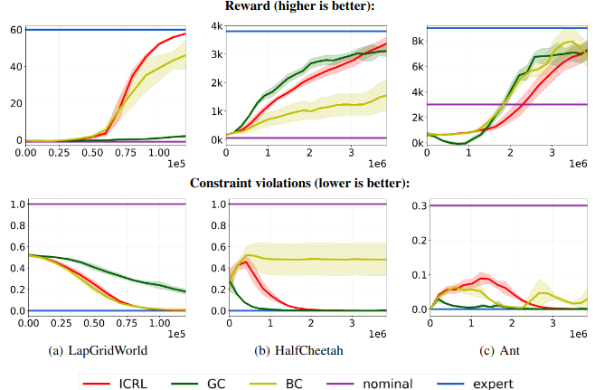
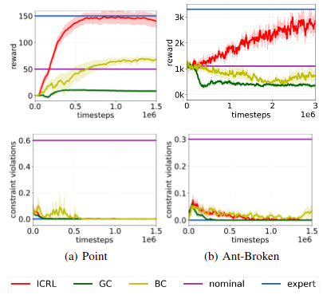
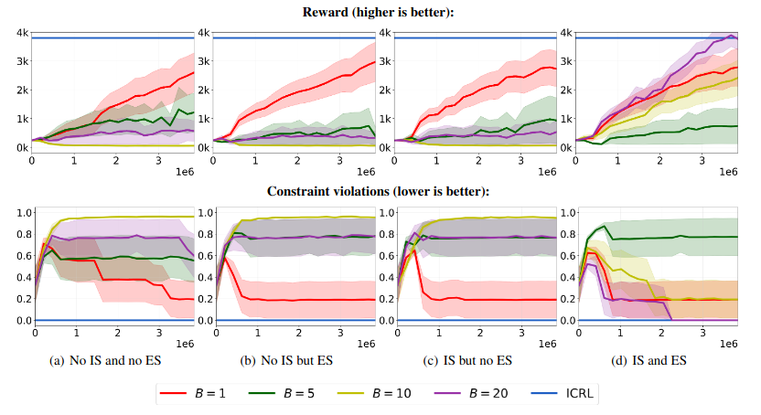
Inverse Constrained Reinforcement Learning
Usman Anwar, Shehryar Malik, Alireza Aghasi, Ali Ahmed
Introduction & Motivation
Training Objective
Training Tricks
Constraints are physically possible actions that should be avoided, for example, driving the car above the speed limit or breaking a traffic signals are examples of constraint violations.
In any realistic environment (e.g. home), there are too many constraints to enumerate.
Focus of this work: automated learning of constraints.
Neural Network based soft parametrization of indicator set over constrained trajectories.
Importance Sampling
Sampling from training RL agent involves solving forward RL problem. That is expensive! Solution: use importance sampling!
Current Neural Network
Sampling Neural Network
Samples From Expert
Samples From Training Agent
KL Based Early Stopping
Contributions
Use KL Based Early stopping to control for variance introduced by IS.
Provide a model free constraint learning method for high dimensional, continuous setting.
Empirically show that learned constraints transfer to agents with different dynamics and morphologies.
Objective can be loosely interpreted as trying to match average soft cost for both expert and RL agent.
Regularizer: Puts Penalty On Over Constraining,
Comparison With Baselines
Transfer Experiments
Ablation Study
We benchmark the algorithm against a binary classifier baseline and a GAIL inspired baseline.
Question: Can constraint net obtained from demonstration of one agent transfer to other agents?
Answer: Yes. Even when new agents differ in morphology or have different dynamics.
Question: What components of the algorithm are critical to its performance?
Answer: All of them!

